Slide 1
PREDICTIVE ANALYSIS
FAKE NEWS DETECTOR
18PD02 - Abhirami M
18PD24 - Pavithra S
18PD30 - S. Rooban

Slide 2
Contents
The problem
The concept behind the solution
The Dataset
TF-IDF vectorizer
Passive Aggressive classifier
References

Slide 3
The Problem
Misinformation can lead to violent responses.
Will lead to people not accepting the truth.
Lot of fake news are spreading these days leading to chaos.

Slide 4
The concept behind the solution
We use two algorithms- TF-IDF Vectorizer and Passive Aggressive Classifier to classify the given dataset.
The goal of the tf-idf vectorizer is to scale down the impact of the words which occur very frequently in the given dataset. Empirically, this means that a lower score is allocated for those words which repeated too often in the text and thus emphasising the words which provide more meaning.
Passive Aggressive Classifier is an on-line learning algorithm which remains passive for a correct classification outcome, and turns aggressive in case of a miscalculation. It is used to fit the model in the correct classification (Real or Fake).

Slide 5
The Dataset
From data-Flair.training
Four columns
Title - Title of the news
Text - The actual news we are going to be using
Label - Fake,Real

Slide 6
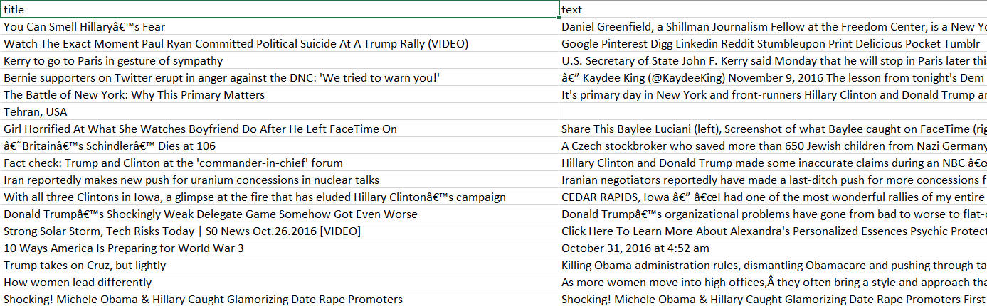

Slide 7
TF-IDF Vectorizer
Case Documents
Ben studies about computers in Computer Lab.
Steve teaches at Brown University.
Data Scientists work on large datasets.

Slide 8
Term Frequency (TF)
TF = (Number of occurrences of a term in a document)/(Total number of terms in the document).
TF | Ben | Studies | Computer | Lab
DOC1 | 0.1428 | 0.1428 | 0.2857 | 0.1428
TF | Steve | Teaches | Brown | University
DOC2 | 0.2 | 0.2 | 0.2 | 0.2
TF | Data | Scientists | Work | Large | Datasets
DOC3 | 0.167 | 0.167 | 0.167 | 0.167 | 0.167

Slide 9
Inverse Document Frequency (IDF)
IDF = log(Total number of documents / Number of Documents containing the term).
N = 3
 | Ben | Studies | Computer | Lab | Steve | Teaches | Brown | University
IDF | 0.4771 | 0.4771 | 0.4771 | 0.4771 | 0.4771 | 0.4771 | 0.4771 | 0.4771
 | Data | Scientists | Work | Large | Datasets
IDF | 0.4771 | 0.4771 | 0.4771 | 0.4771 | 0.4771

Slide 10
TF-IDF Vectorizer
TF-IDF = TF * IDF
TF-IDF | Ben | Studies | Computer | Lab
DOC1 | 0.0681 | 0.0681 | 0.1363 | 0.0681
TF | Steve | Teaches | Brown | University
DOC2 | 0.0954 | 0.0954 | 0.0954 | 0.0954
TF | Data | Scientists | Work | Large | Datasets
DOC3 | 0.0796 | 0.0796 | 0.0796 | 0.0796 | 0.0796

Slide 11
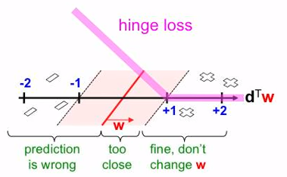
Passive Aggressive Classifier
initialize w = (0, . . , 0)
data = all_documents
vectors = tf_idf vectorizer(data)
from vectors:
receive new vector d
y = d^{t} . x
y^{t} = {-1,+1}
loss = max(0, 1 - y.y^{t})
k = loss/||x||²
w = w + k.x.y^{t}

Slide 12
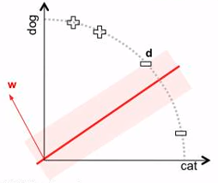
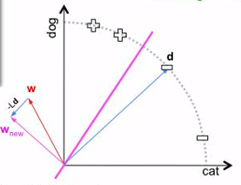

Slide 13
References
Text Classification 3: Passive Aggressive Algorithm : https://www.youtube.com/watch?v=TJU8NfDdqNQ
Koby Crammer. Online Passive-Aggressive Algorithms. Journal of Machine Learning Research, 7:551–585, 2006.
Data-Flair: https://data-flair.training/blogs/advanced-python-project-detecting-fake-news/

Slide 14
THANK YOU

